Slide 1
Binary classification to multi-class classification
By: Steven Cao

Slide 2
What is the difference between binary classification and multi-class classification in the target values?
Binary Classification
Binary classification is the task of classifying the elements of a set into two groups
Multi-Class Classification
Multiclass classification is the problem of classifying instances into one of three or more classes
Binary Classification
Target Values:
Y_train.shape -- > 17,510 * 1
For one training sample, there is only one ground truth, represented by a 0 or 1
Ex. [1]
Multi-Class Classification
Target Values:
Y_train.shape -- > 17,510 * 5
For one training sample, instead of having only one ground value, there are 5 outputs, with 1 representing its class and 0 represents this is not this class.
Ex. [0,0,0,1,0]
Conclusion: There is a difference in the target values

Slide 3
What is the difference between binary classification and multi-class classification in the output as well as activation functions?
Binary Classification
The neural network architecture is: 187 * 128 * 64 * 1
It outputs only one value 0 or 1
Ex. [0]
Multi-Class Classification
The neural network architecture is: 187 * 128 * 64 * 5
It outputs 5 values, each representing the probability for each class.
Ex. [0.53, 0.03, 0.26, 0.16, 0.02]
Binary Classification
Uses Sigmoid as its last activation function before the output to squash the values between 0 and 1 for binary classification.
Ex. [0.14]
Multi-Class Classification
Uses Softmax as its last activation function before the output to give probability distributions for each class, and summing it up to 1 by squashing the values between 0 and 1.
Ex. [0.53, 0.03, 0.26, 0.16, 0.02]
Conclusion: Multi-Class Classification uses different activation functions and outputs multiple values for each training sample.

Slide 4
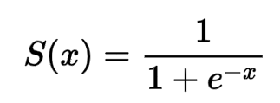
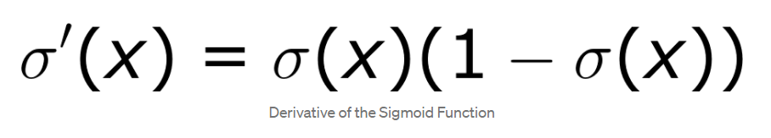
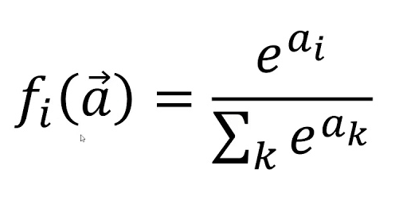
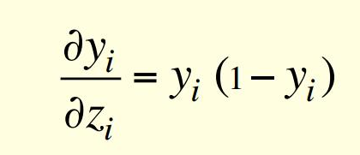
What is the difference between binary classification and multi-class classification during forward propagation?
Binary Classification
Backpropagation: We used sigmoid activation function, we need the derivative of the sigmoid activation function.
Multi-Class Classification
Backpropagation: We used the softmax activation function, so we need the derivative of the softmax activation function.
Sigmoid
Derivative of Sigmoid
Softmax
Derivative of the softmax
Conclusion: Need to change the derivative of sigmoid to softmax for backpropagation

Slide 5

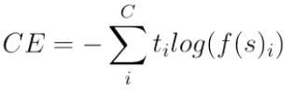
What is the difference between binary classification and multi-class classification in backpropagation?
Binary Classification
Uses the binary cross-entropy loss function
Which is basically the sum of a cross-entropy loss function but with two classes.
Multi-Class Classification
Uses the categorical cross-entropy loss function
Why?: Because we only want to see if that class that we predicated is correct or not.
Ex. Our prediction = [0.03, 0.53, 0.26, 0.16, 0.02]
Target prediction = [0 , 1, 0 ,0, 0]
Conclusion: Multi-Class Classification uses a different variants of the cross-entropy loss function.

Slide 6
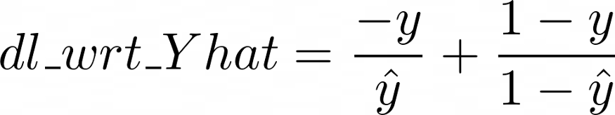
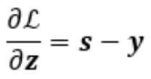
What is the difference between binary classification and multi-class classification in backpropagation?
Binary Classification
Derivative of the cross-entropy loss function:
Multi-Class Classification
Derivative of the categorical cross-entropy loss function
Conclusion: For multi-classification, we now have the dl_wrt_yhat needed to backpropagate and update the weights.

Slide 7
How to convert from binary classification to multi-class classification?
Binary Classification
Uses np.round() for predictions
Because there is only two classes 0 and 1.
Ex. 0.14 → turns into → 0
Multi-Class Classification
Uses np.argmax() for predictions
Because you want to get the highest probability out of those 5 probabilities.
Ex. [0.03, 0.53, 0.26, 0.16, 0.02] -- > turns into [1]
Conclusion: I now know how to do predictions of a multi-class classification problem

Slide 8
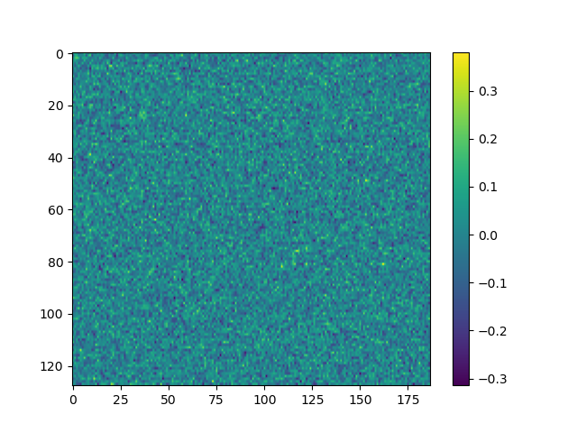

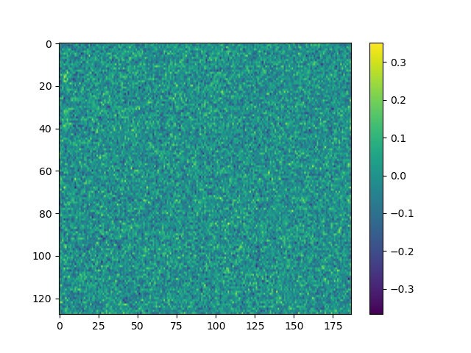

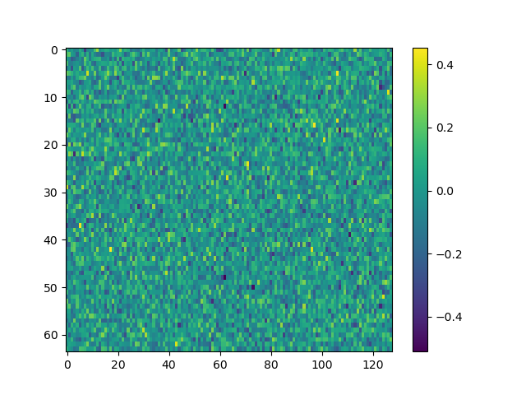
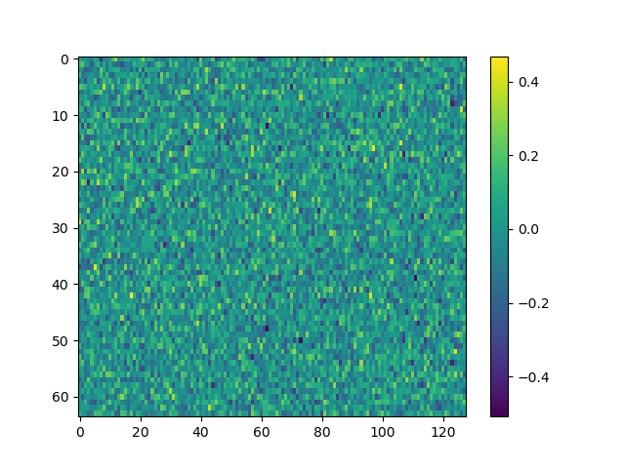
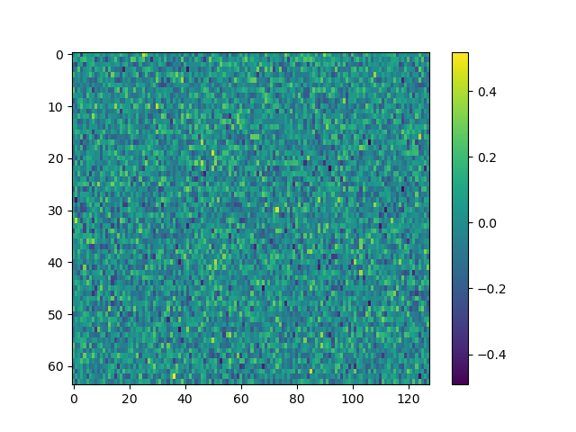

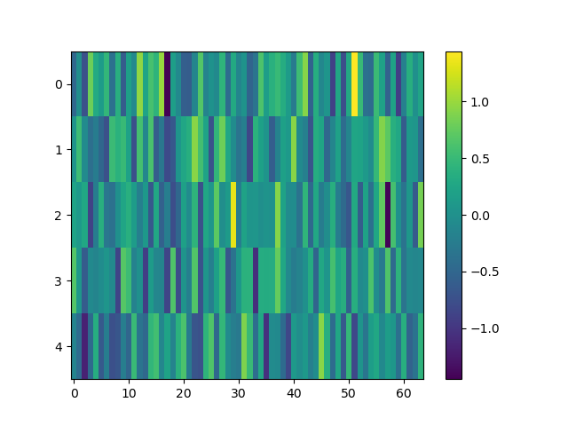
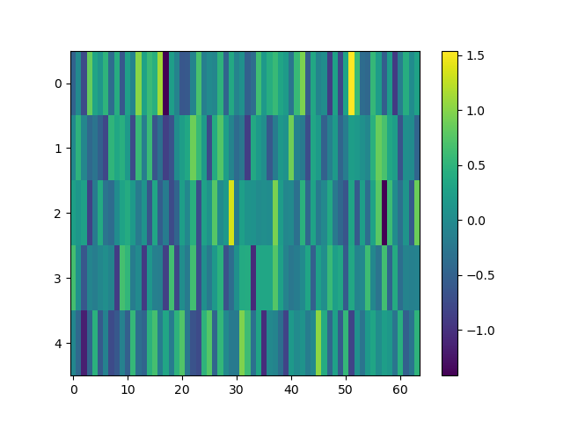
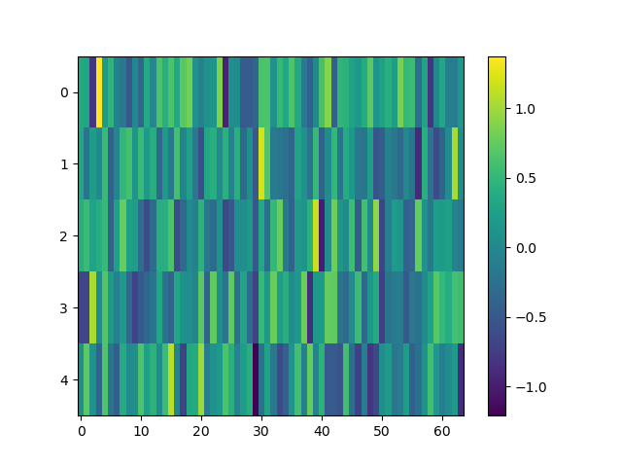

Let’s check the weights after each iteration to see if what we are doing is right
Weights 1
Weights 2
Weights 3
Iteration 1
Iteration 2
Iteration 3
Iteration 4

Slide 9
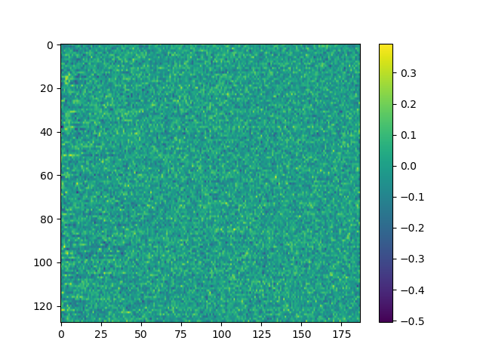



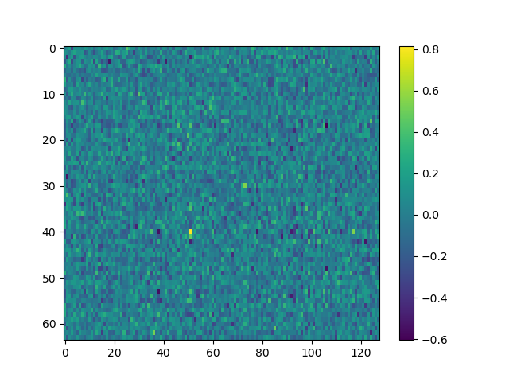
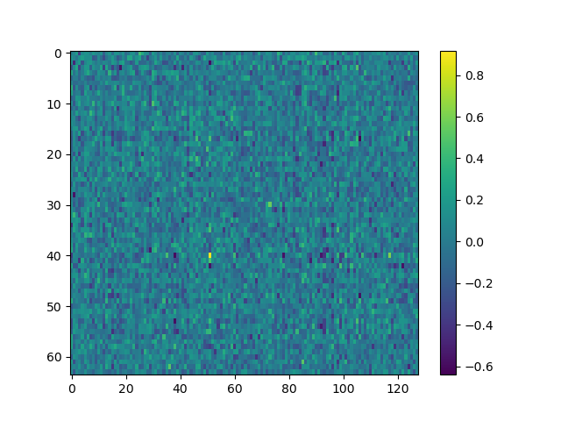
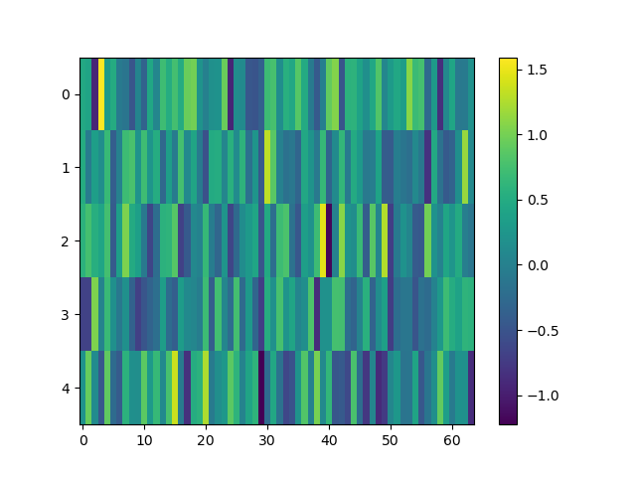
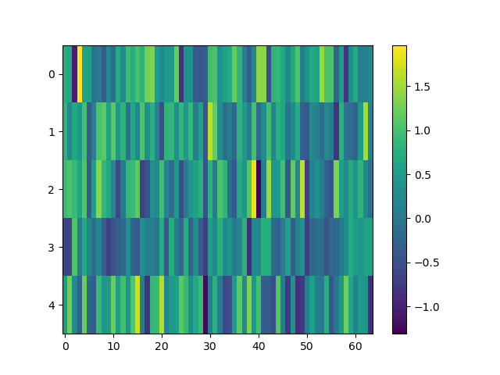
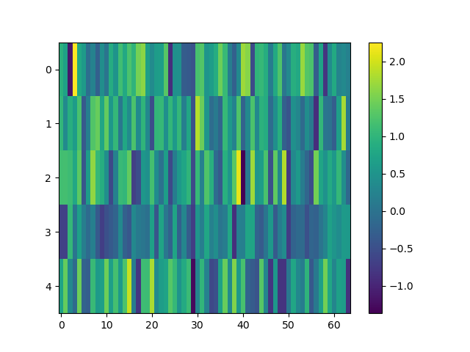
Let’s check the weights after each iteration
Weights 1
Conclusion:
The weights look normal and nothing weird is happening.
Weight 2
Weight 3
Iteration 10
Iteration 20
Iteration 30

Slide 10




Let’s check the performance of our model and see if it is learning
Epoch: 1, Time Spent: 43.54s, Accuracy: 87.83%
Epoch: 2, Time Spent: 58.98s, Accuracy: 89.15%
Epoch: 3, Time Spent: 131.68s, Accuracy: 90.16%
Epoch: 4, Time Spent: 202.92s, Accuracy: 91.11%
Epoch: 5, Time Spent: 217.95s, Accuracy: 91.74%
Epoch: 10, Time Spent: 303.01s, Accuracy: 93.08%
Epoch: 15, Time Spent: 467.86s, Accuracy: 94.02%
Epoch: 20, Time Spent: 552.95s, Accuracy: 94.71%
Epoch: 25, Time Spent: 701.36s, Accuracy: 95.10%
Epoch: 30, Time Spent: 848.65s, Accuracy: 95.28%
1st epoch
2nd epoch
Conclusion: It is learning and has a good accuracy

